Slide 1
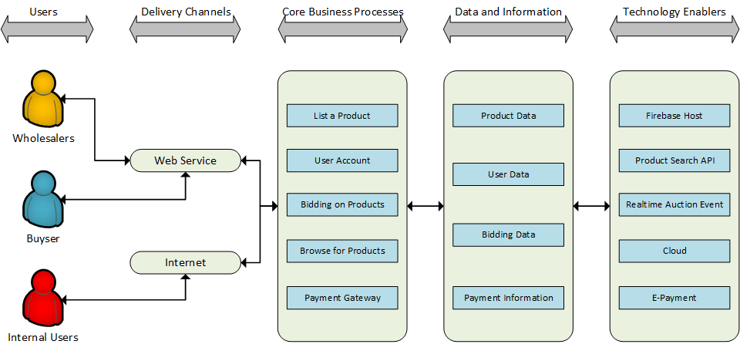
BundleBid Web Application Architecture Type: Application Architecture View: Logical View Style: Layered Architecture Pattern

Slide 2
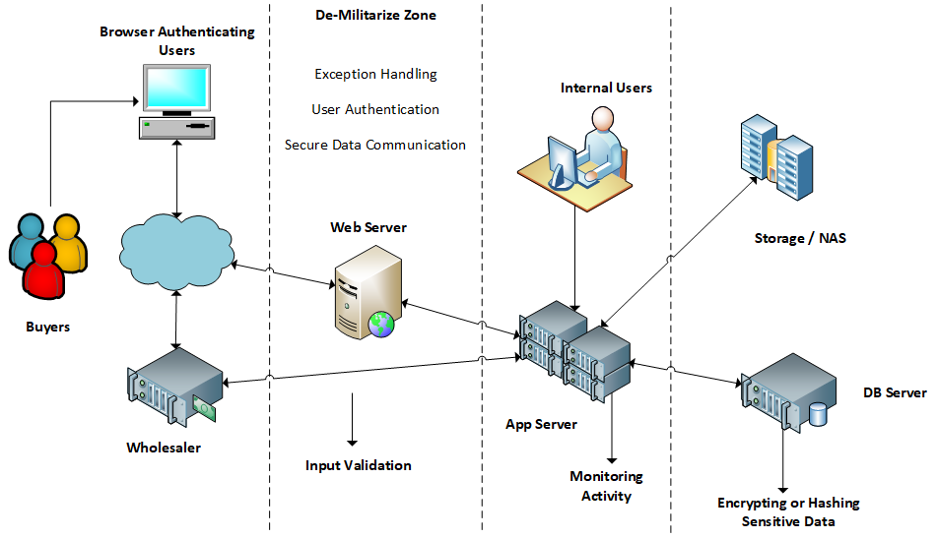
BundleBid Web Application Architecture Type: Application Architecture View: Process View Style: Client-Server Architecture Pattern

Slide 3
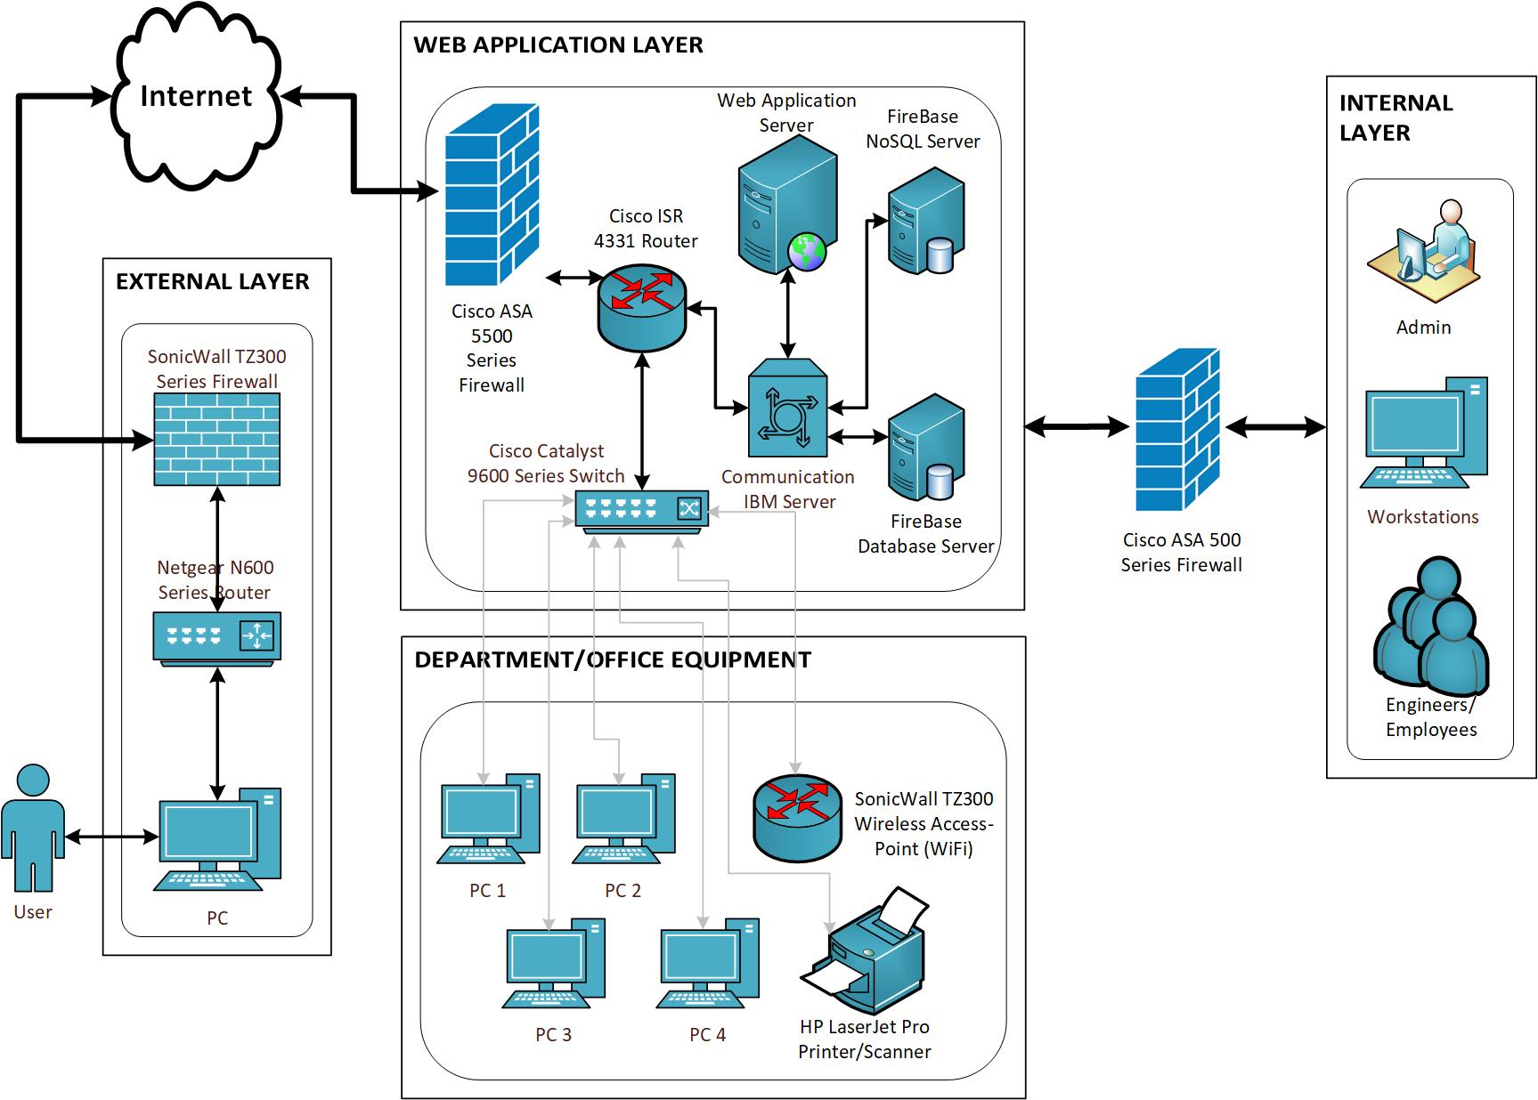
BundleBid Web Application Architecture Type: Application Architecture View: Physical View

